Slide 1
CS 498 VR
VR
Design & Development
Methodologies
(For internal use only)
Set 2

Slide 2
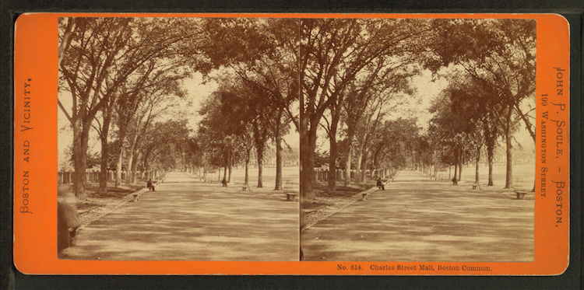
History of VR
1838: Stereoscopic Vision – Invented by Charles Wheatstone, it brought depth to photography via a viewer and special slides

Slide 3
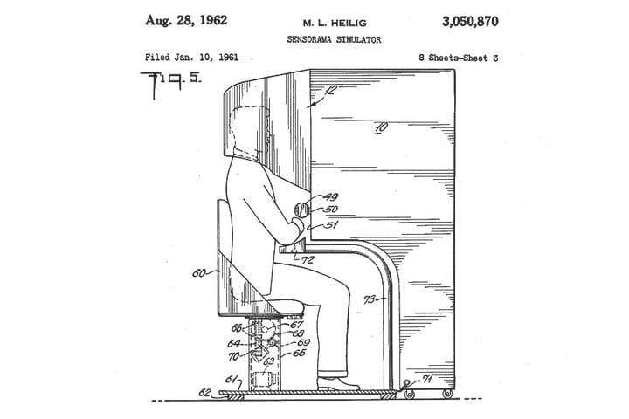
History of VR
1952: Sensorama - Morton Heilig created a device to address all sensory input, it included stereoscopic 3D display, fans, smell generators, stereo speakers and a vibrating chair. He built working models in 1956 and made several movies for the device.

Slide 4
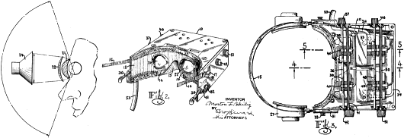
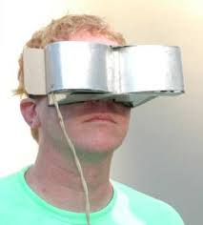
History of VR
1960: Telesphere Mask – Heilig followed up with what is considered to be the first HMD. It featured stereo 3D as well as wide vision and stereophonic sound.

Slide 5
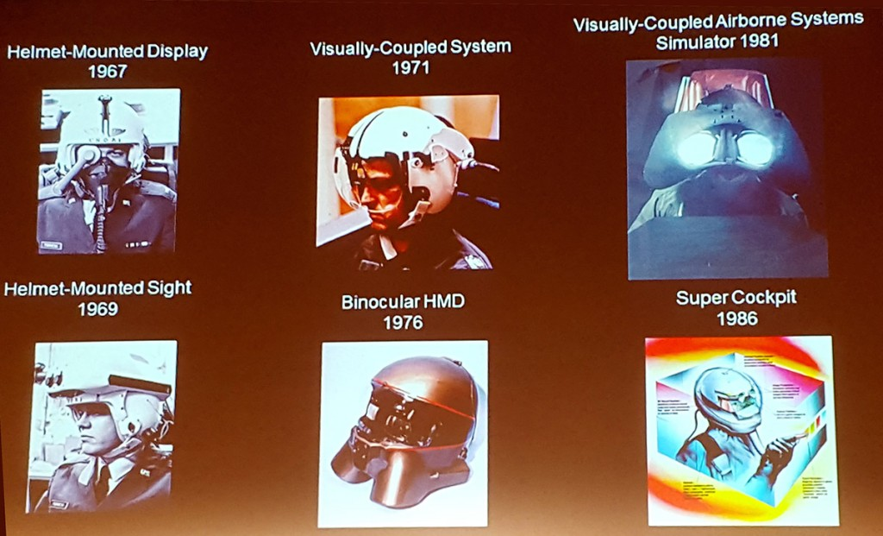
History of VR
1960s: Super Cockpit Program – Tom Furness, working in the Air Force, created some of the first HMDs. He worked on fully immersive cockpit simulations for 20 years before leaving and working at the forefront of VR at the U. of Washington.
He created Human Interface Technology Lab and the Virtual World Society to drive VR in the educational realm.

Slide 6
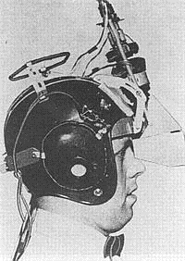
History of VR
1961: Headsight – Developed by Comeau and Bryan, engineers from the Philco Corporation) engineers (Comeau & Bryan) developed the first precursor to the HMD as we know it today – the Headsight. Each eye had a video screen and there was a motion tracking device that linked to a remote camera, moving your head moved the camera. Headsight was the beginning of modern HMD but it lacked computer integration and with that, computer generated images.

Slide 7
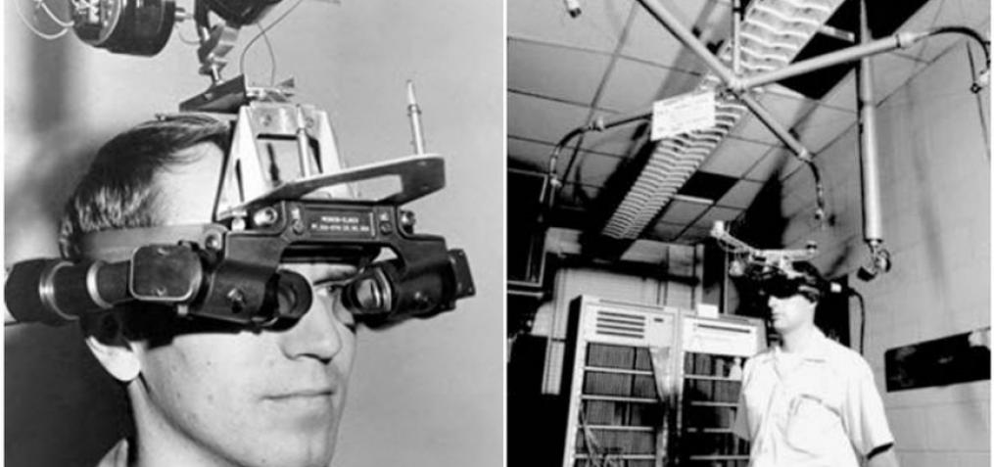
History of VR
1965: Ivan Sutherland, MIT scientist, described the “Ultimate Display” concept, a description of Virtual Reality that became a blueprint for what modern VR became.
1968: Sword of Damocles project – Sutherland created the first VR HMD attached to a computer. It was tethered to a telescoping arm that hung over the user, hence the name, collecting data on head tracking while simple geometric shapes were shown via a stereoscopic display.
https://vrroom.buzz

Slide 8
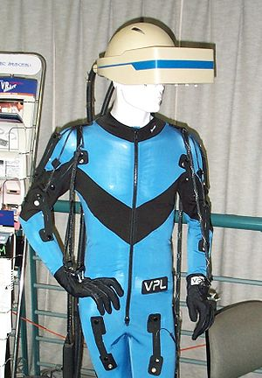
History of VR: VPL Research
1987: - The term Virtual Reality is popularized by Jaron Lanier and the he went on to create VPL Research which built various items in support of VR including :
the DataGlove (a major development in VR haptics)
the Datasuit
Eyephone (HMD)
Cost for the full set was around $350,000 in 1990

Slide 9
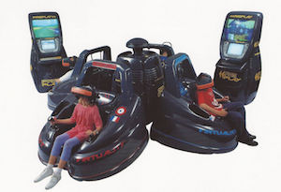

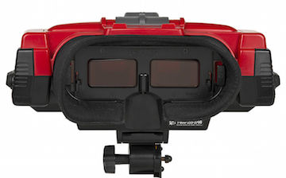
History of VR
1990s: VR Goes Mainstream
1991: Virtuality Group
launched a range of VR arcade games and machines
1993: Sega VR (never Shipped)
1995: Nintendo Virtual Boy

Slide 10
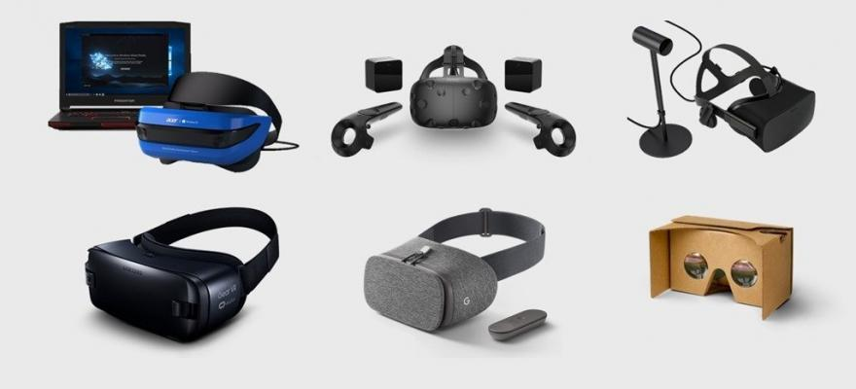
History of VR
2010: 18-year-old entrepreneur Palmer Luckey created a VR prototype called the Oculus Rift. He raised over $2M in a Kickstarter and created huge consumer and corporate interest in VR, sold to Facebook for $2B in 2014.
2015-2016: Various VR systems shipped
Oculus Rift
HTC Vive (in conjunction with Valve)
Samsung Gear
Playstation VR
Google Cardboard
2018 & 2019
Oculus Go
HP Reverb
HTC Vive Focus
Oculus Quest
Oculus Rift S

Slide 11
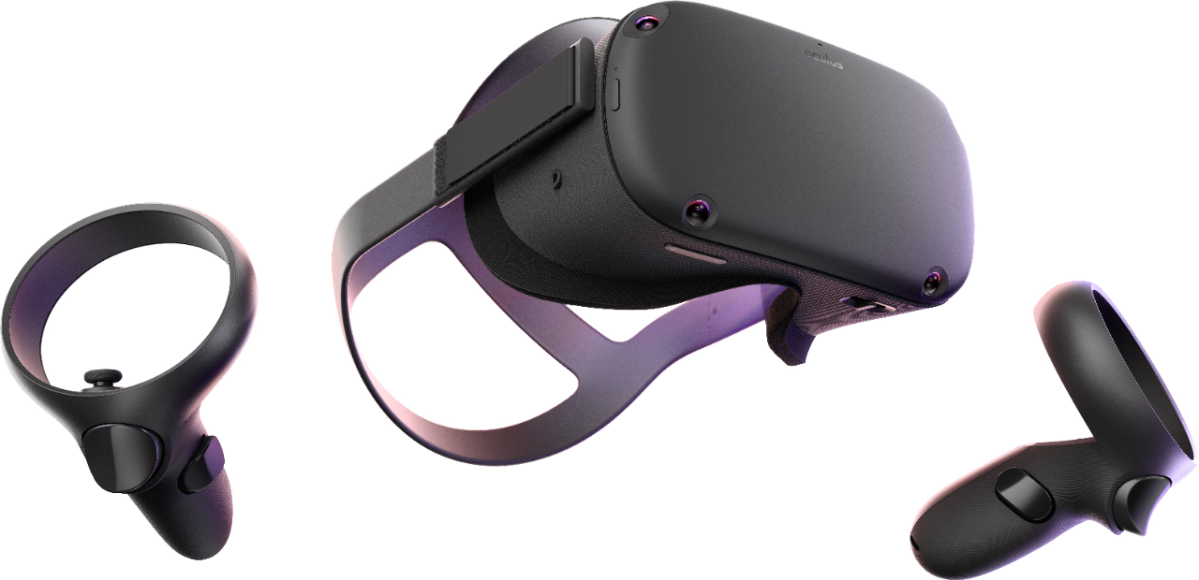
History of VR
2019: Breakthrough with the Quest
Standalone (non-tethered) at $400 or $500 depending on ram.
Add-ons include Hand tracking and tethering via a USB cable

Slide 12
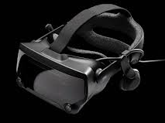
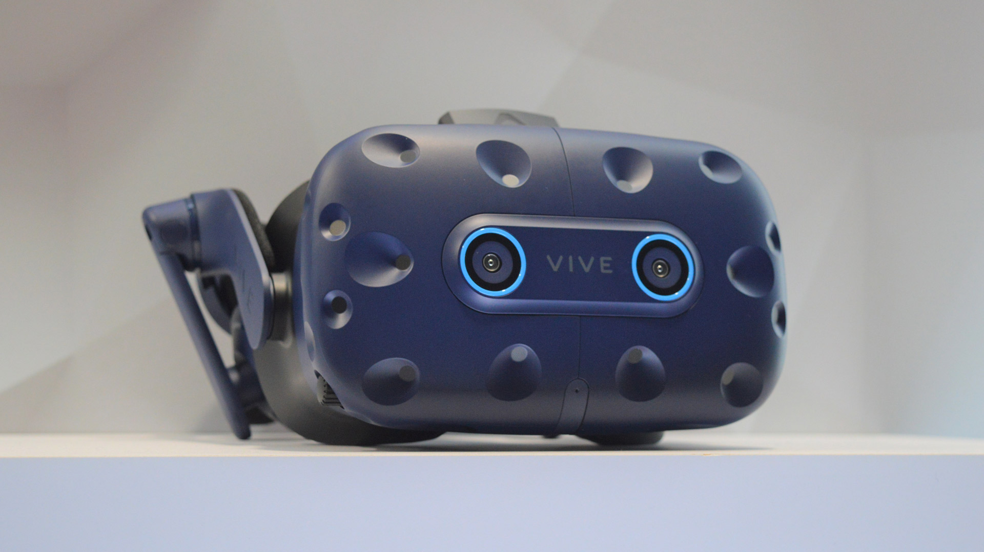
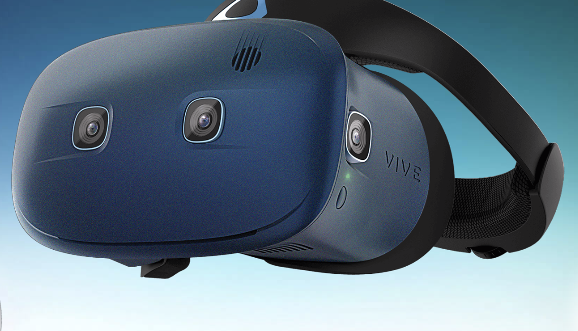
History of VR
2019: Valve Index, HTC Vibe Pro with Eye tracking, HTC Cosmos
Valve Index Features
High Comfort
Excellent Controllers
Vive Pro Features
Foveated rendering
“gaze-oriented menu navigation"
Cosmos Features
Modular, higher res,
Flip-up screen, still tethered

Slide 13
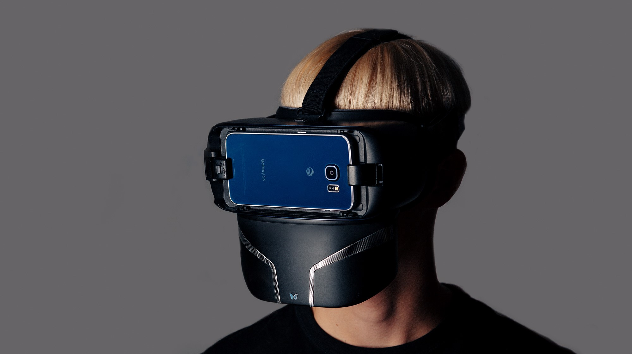
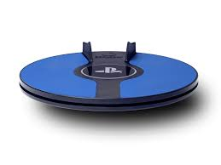
History of VR: 2019 Peripherals
Feelreal - Modern version of the original Sensorama. Feelreal is a new company producing a VR mask add-on that provides olfactory, water, hear, wind and vibration feedback for the current VR masks.
3dRudder: Foot controller for PSVR, removes teleporting and reduces motion sickness
Feelreal.com

Slide 14
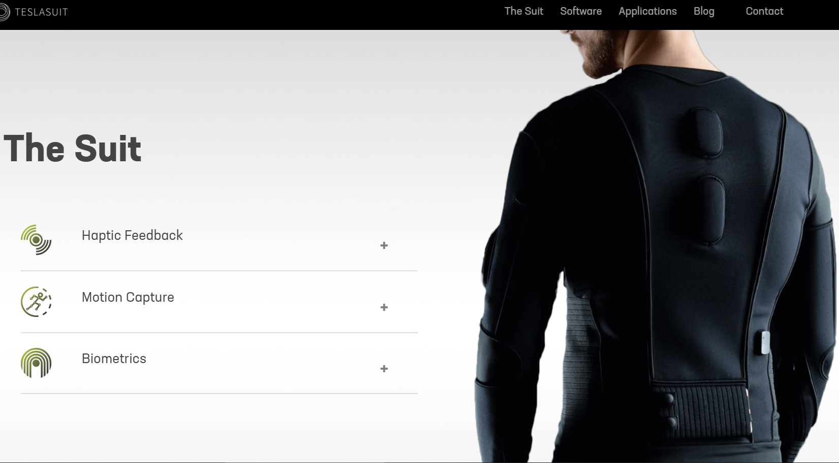
History of VR: 2019 Peripherals
Teslasuit (teslasuit.io): Full body suit with haptics, motion capture and biometrics.

Slide 15
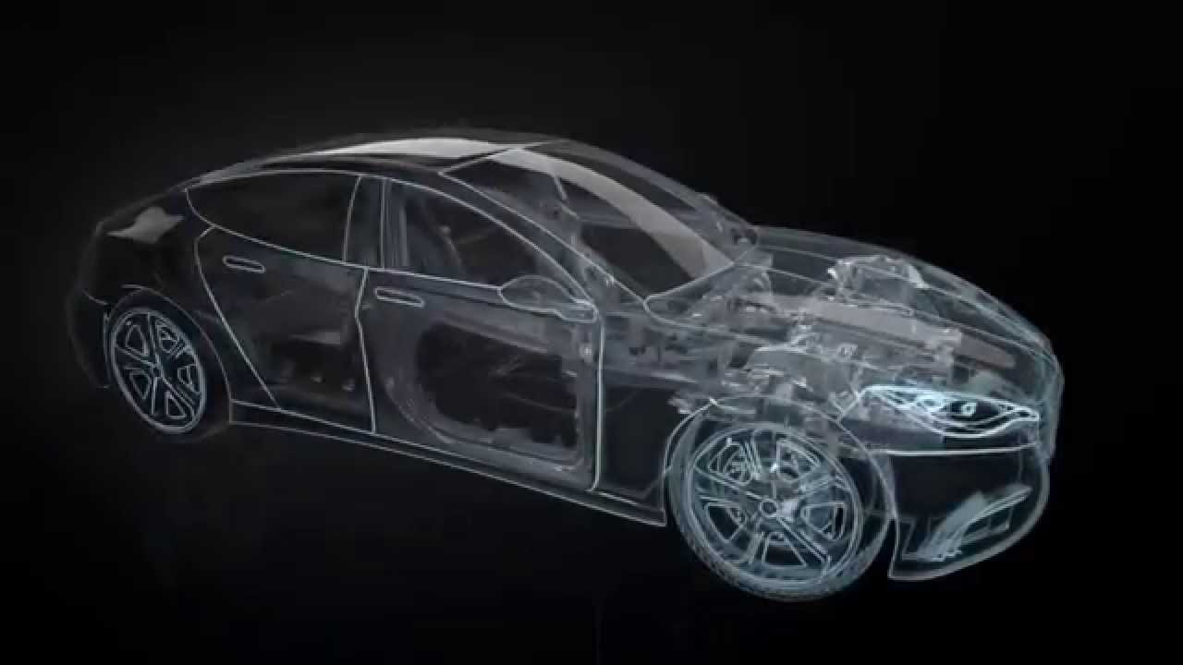
System Driven design (or as I call it, Top Down Design)
Analogous to Automotive Design
User types
User experiences
Systems first then features
Getting better at the process
We are a young industry
GTA2
Ubisoft
Copyright Fisher Automotive

Slide 16

Principles of Design: Starting Points
All apps/games start with an IDEA
There is so much more to what you want to build
The primary role of a designer is to clearly communicate how that IDEA fits into an App/Game (the bigger picture, the Vision)
What happens without that clarity?
Confusion
Delay
People building to their own vs. the required standards
The question is: what focuses the design, what drives the definition of the Vision?

Slide 17

Principles of Design: Starting Points
Once you have an idea, build a world around it
Provides Context
Provides Consistency
Expand upon the idea to provide depth
An idea is a feature in most cases, a feature is not a game
Why is the world the way it is? Leads to new complementary ideas
Examples: Renegade and Red Faction Guerrilla
Improve Immersion/Presence
Most games are Skill Challenges
Skill develops over time, the world encourages retention
Interactivity can add another layer

Slide 18
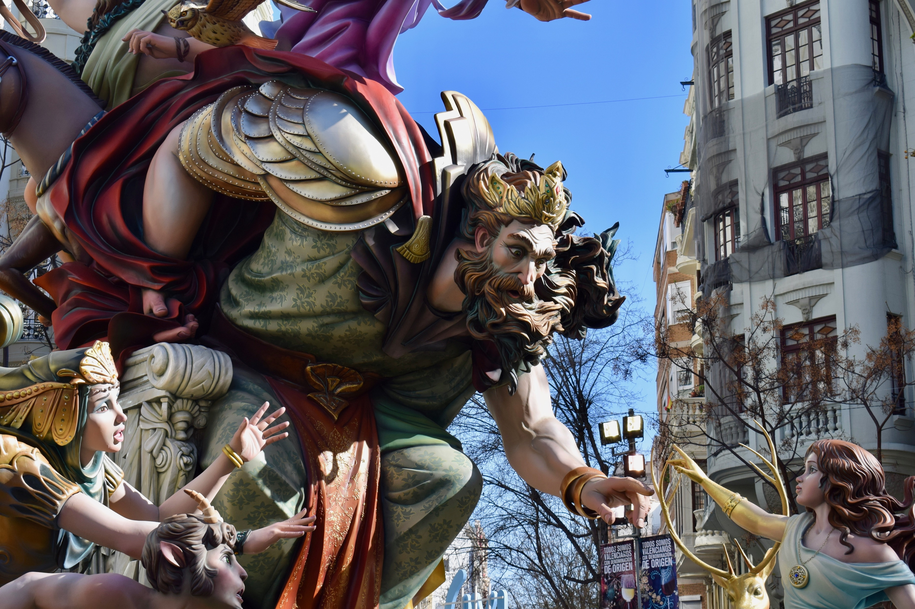
Principles of Design: Defining a World
Art Style
Environment
Characters
Personas
Skills
Culture
History
Beliefs
Relation to the real world:
Is it realistic?
How does it vary?
Examples:
Candy Crush, Elder Scrolls, Saints Row (Characters)
https://www.dreamstime.com/publicdomainphotos_info

Slide 19
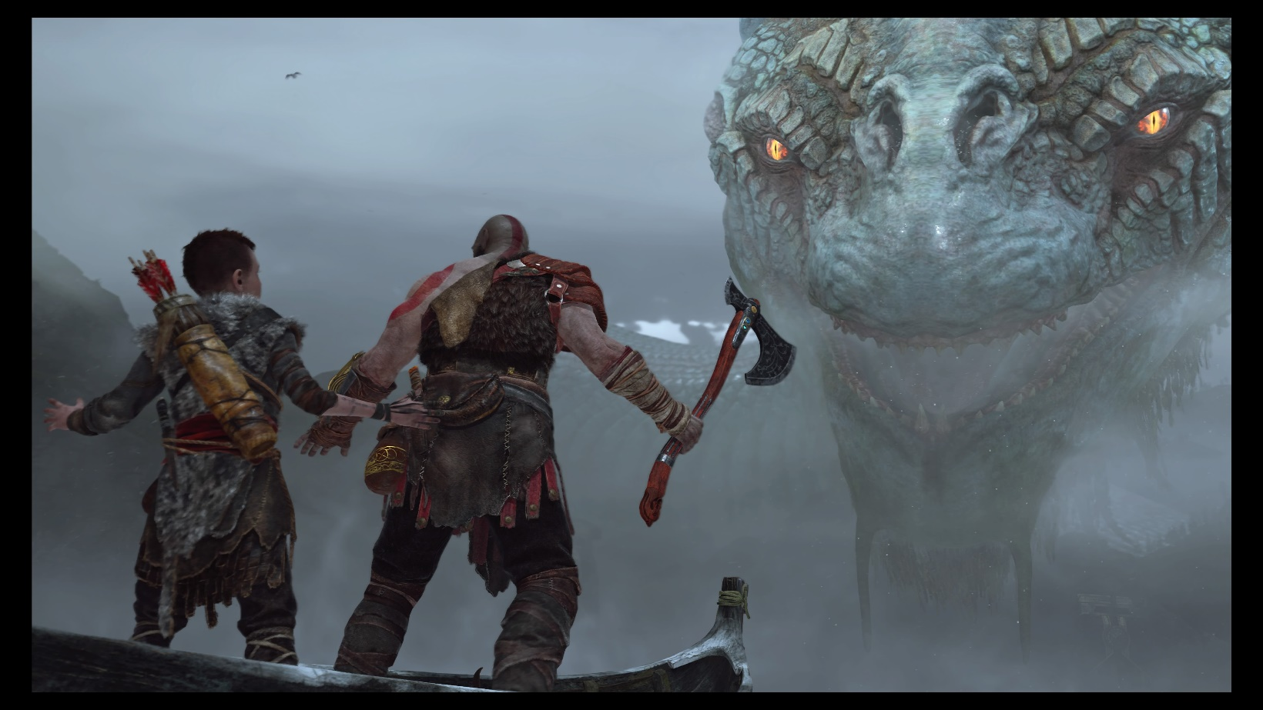
Principles of Game Design: Starting Points
Determine your constraints.
Constraints lead to better designs
Genre and IP/Genre are constraints in themselves
Define your User Experience(s):
The different emotional responses we are trying to elicit with our app/game features
Example: We want the gamer to be in awe when they face the challenges of our world.
Copyright God of war 4

Slide 20
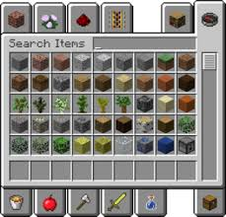
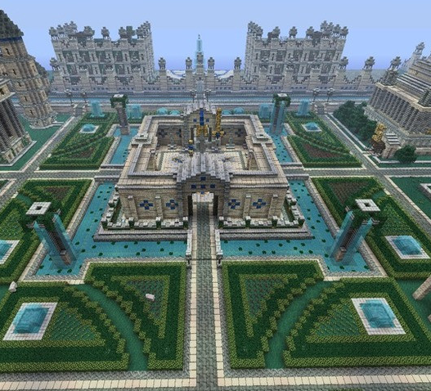
Principles of Game Design: Starting Points
User Types: These define the core interests of the user we are targeting with our features.
Example: Minecraft
The Collector:
This user requires the opportunity to gather items and build a large stockpile of items.
The Builder:
This user type enjoys creating different imaginative items from the resources available.

Slide 21
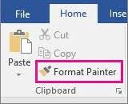
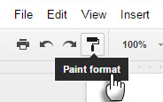

Principles of Design: General
Design from the user’s perspective, their experience:
What are they seeing, thinking and FEELING as they move through your app/game?
Fulfill the user’s low-level expectations, make them feel comfortable
Think about the difference between Microsoft Word & Google Docs Format Painter
Make the user’s path or choices clear and meaningfulayers want to be successful (remember to avoid punishing failure)

Slide 22
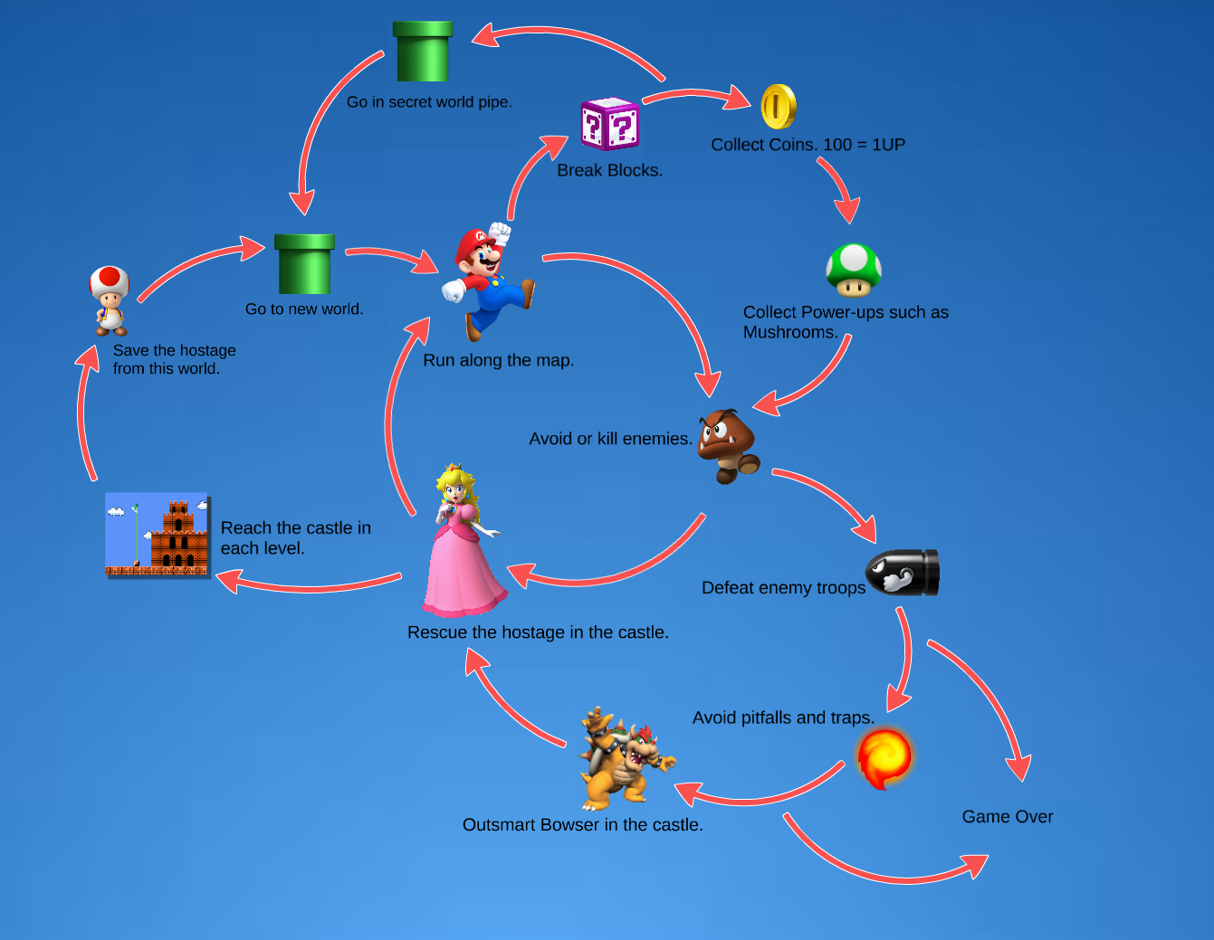
Principles of Game Design: General
Everything you design should be a loop
Most Skill Test Games use the following low-level loop:
See enemy, engage enemy, kill enemy, loot, repeat
Turn based and RTS games often use this low-level loop:
Select unit, move unit, combat/gather, repeat
By Ethan Stanaway https://prezi.com/gyqljrywdmzu/super-mario-bros-core-game-loops-and-reward-structures/

Slide 23

Principles of Game Design: General
Immersion
We will talk quite a bit more about this
VR has a different set of issues in this area
Absence is the enemy
When something is missing it is stands out

Slide 24
Principles of Design: For Games
REMEMBER to Iterate to fun
Don’t trust your view of fun
Get audiences of people that fit your player types to test your game
When they tell you its fun you have something

Slide 25
The Top Down Design Process
We are going to put you on a team
If not a Sponsored Project, your team will decide on a design
Your team will figure out your audience and then create a High-level Vision Canvas
User Experience
User Types
Do a mid-level breakdown of the design leading to a strong list of features
Game Loop: Mid level action flow (still fairly general) showing how the app/game works
Beat by Beat: Narrative walk through of the actions/play used
Create a prioritized list of the features/systems in your app/game
This will give you the elements you need to start building your project plan

Slide 26
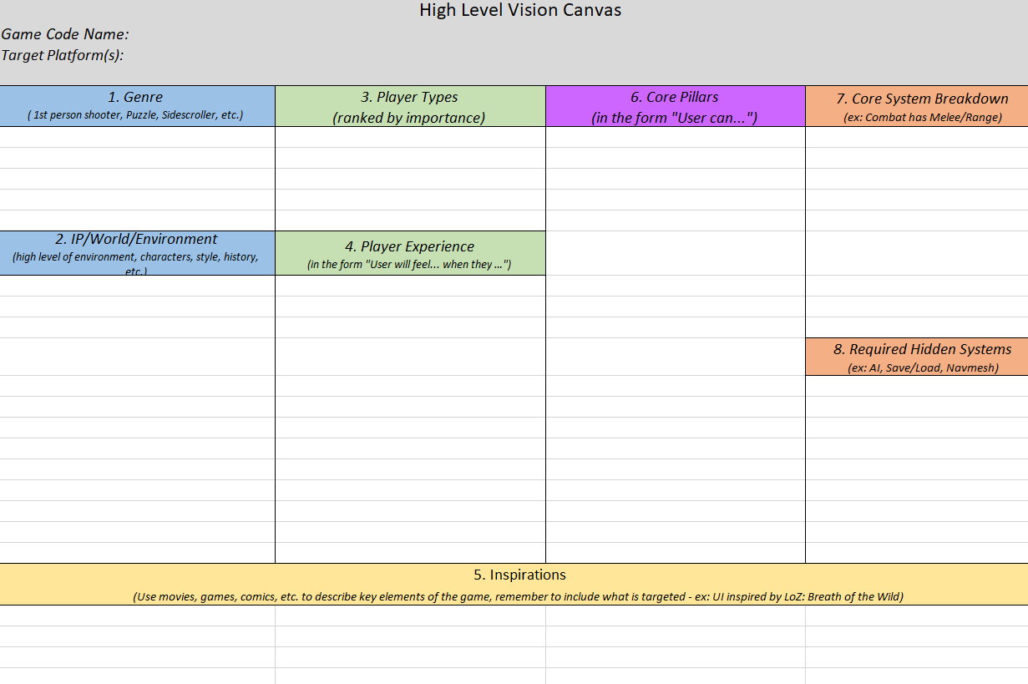
Vision Canvas – Single Project/Level Version
The layout is important
App/Game Name, Platform
Descriptors
Genre
IP/World
Targets
User Types
User Experience
Inspirations (for all categories)
Core Pillars
Systems
Core Systems
Required/Hidden Systems

Slide 27

Considering/Describing the Audience
Design requires consideration for an audience
Designers often design for an audience of 1
Platforms help define the audience
Mobile, iOS
Console/PC
The style provides another level
First person/3rd/God game (real time/turn based)
Non-game apps have methods/styles users expect
Genre can constrain it even more
RPG, Open World, Shooter, Platformer, etc.
Spreadsheet, Written Doc, Travelogue, etc.
Of course it all blends somewhat but people have preferences
And you can go even lower (we defined our own)
In games we use: rule breaker, grinder, collaborator, customizer
Define them any way you want but be consistent and make sure the team understands the target.
You Suck

Slide 28
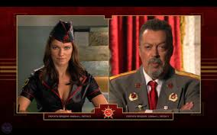
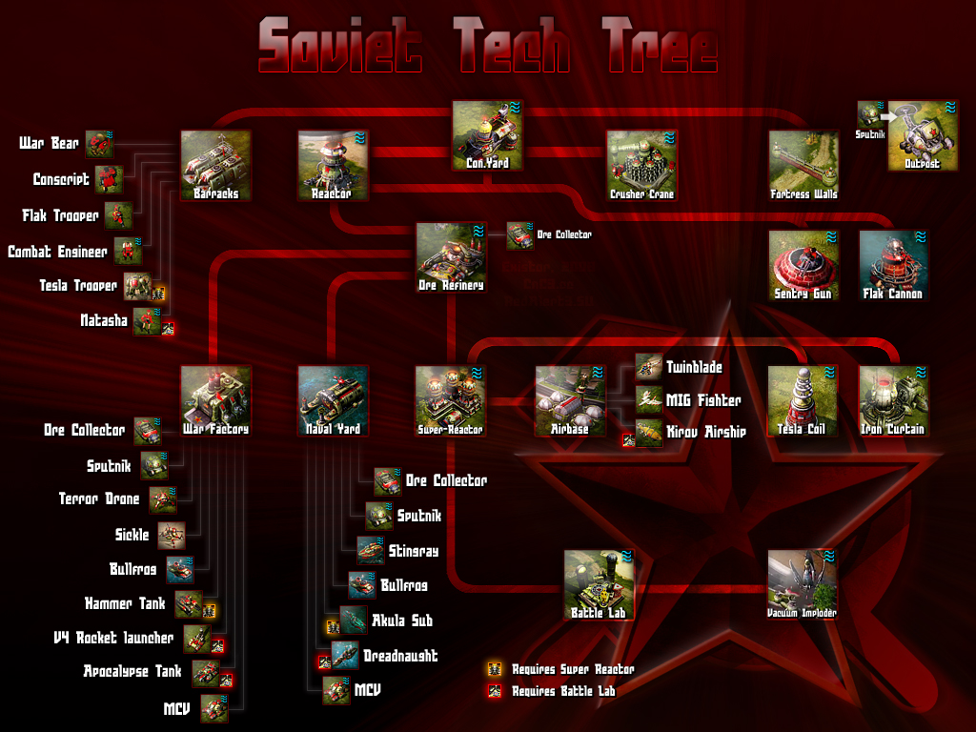
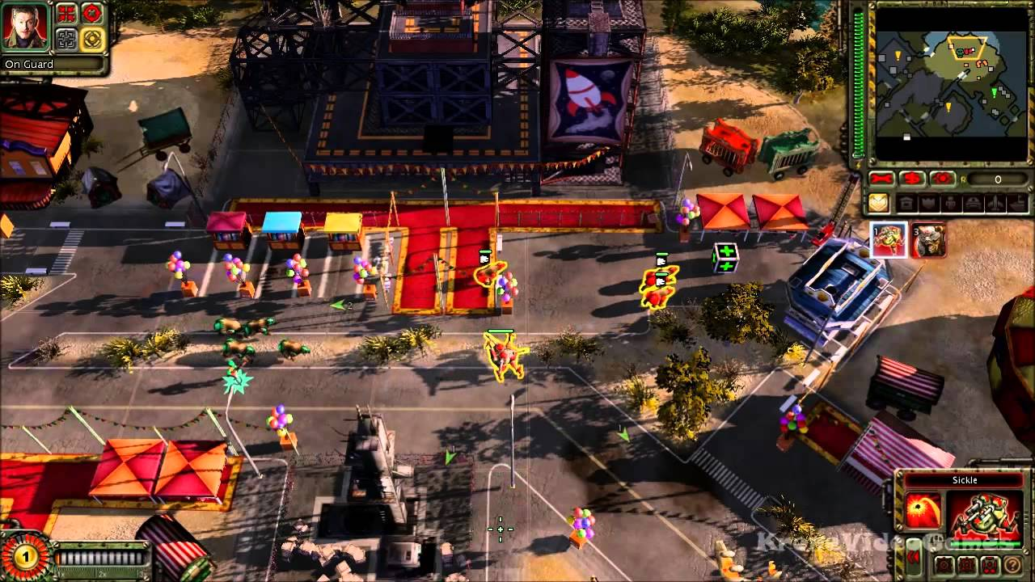
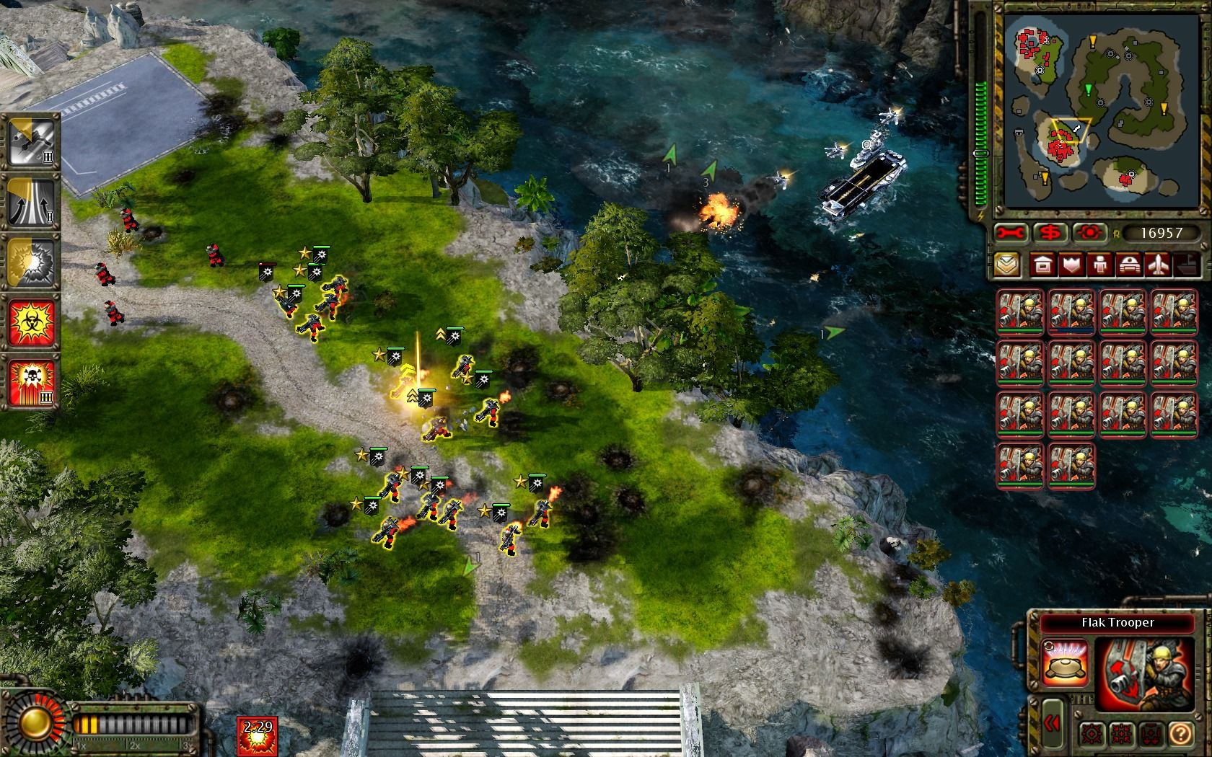
Vision Canvas: App/Game Specifics: Red Alert 2, Westwood
Genre: RTS
Setting: Alternate history, the Cold War in a world without Hitler
Core Pillar examples:
Building Units, Buildings
Mining resources (ore & gems)
A crazy storyline supported B movie actors cinematics
Game play system examples:
Animation for units & buildings
Resource collection & spending
Campaign System
Cinematic player
Hidden Systems examples:
Mulitplayer
Load/Save
AI
Audio/UI/etc.

Slide 29
Design Docs Process: Simple Action Loop
Win/Lose, no repeat
Lose, repeat
Start
S01
Home Base
S02
Mission
S03
Combat
S04
Death

